Slide 1
Deconvolution of RTD for compartment models via CNNs
Tuana Oyuncu
06/08/2024

Slide 2
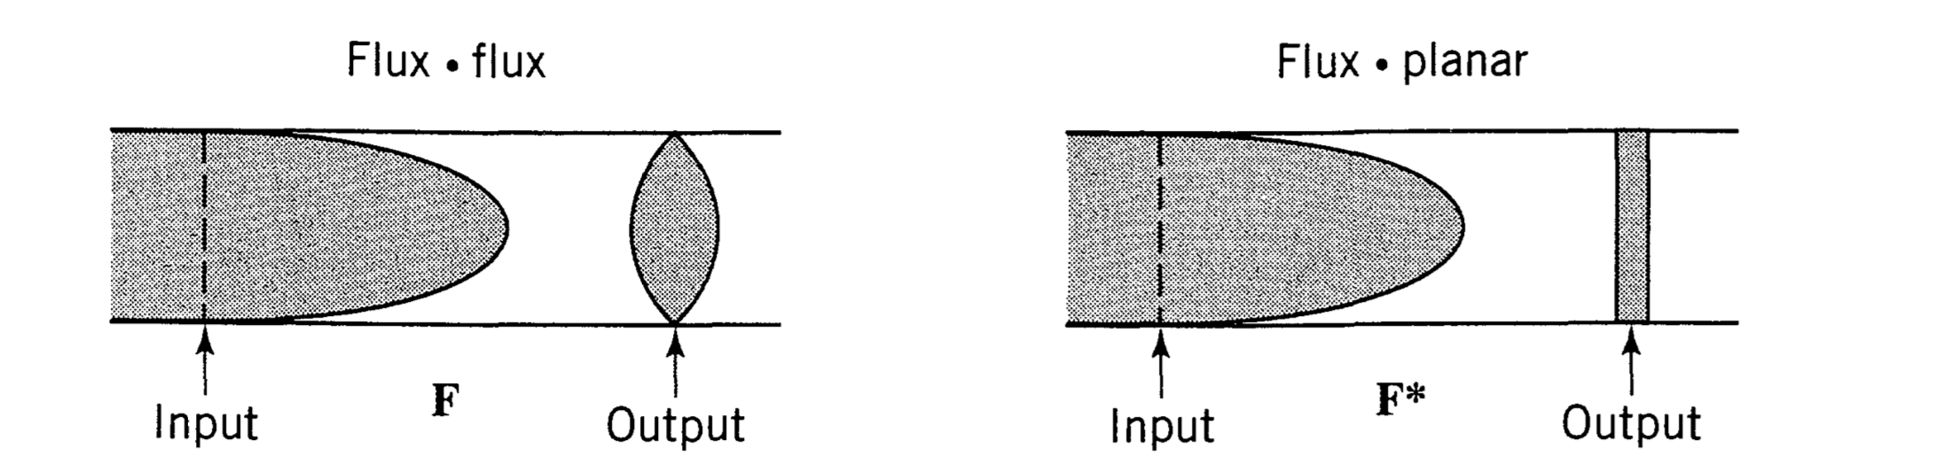
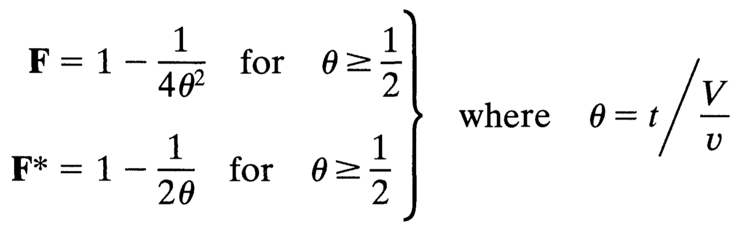
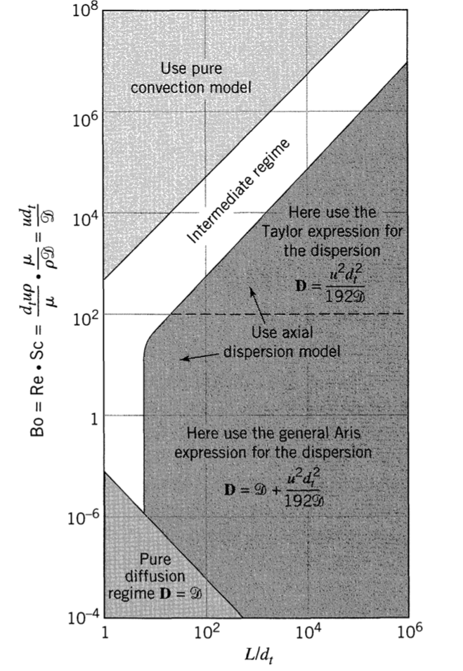
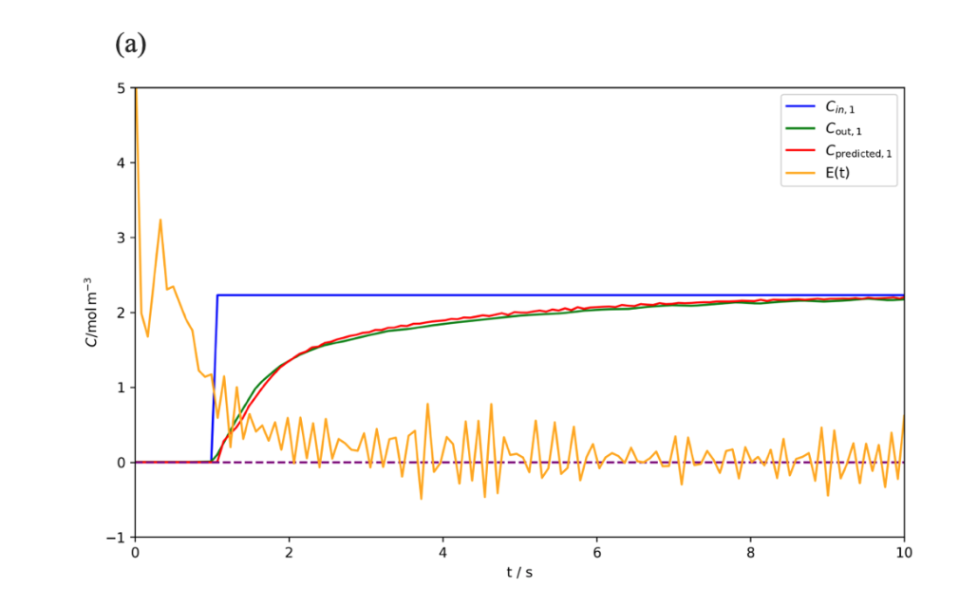
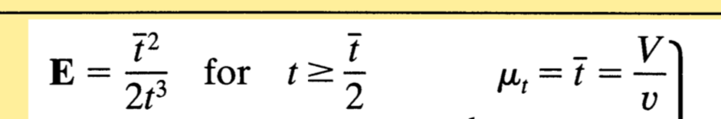
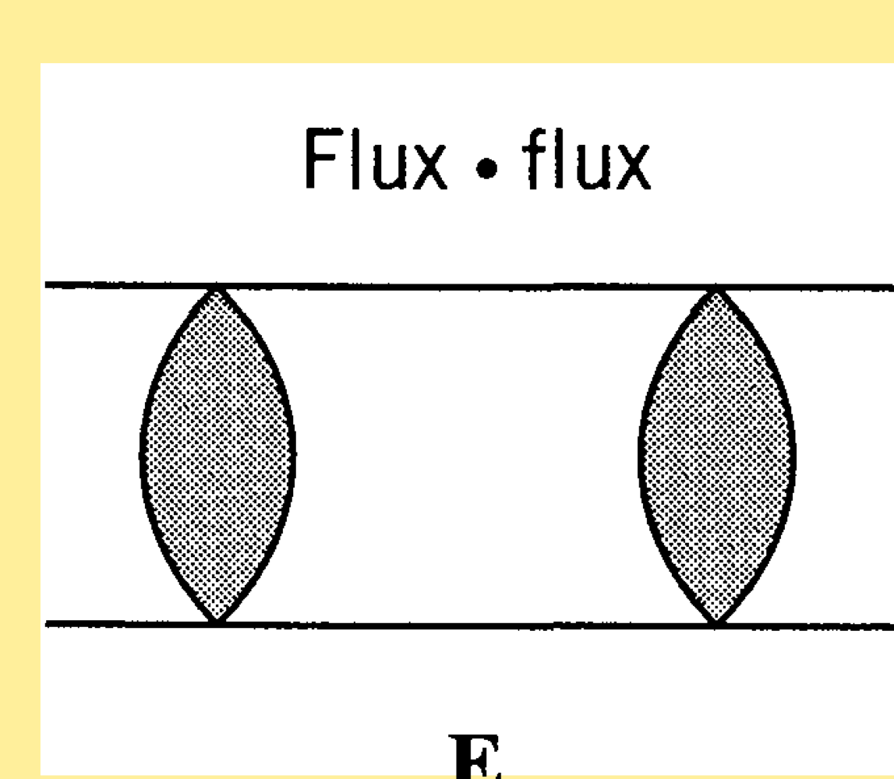
The Convection Model For Laminar Flow
Reasons
- Low Re for the tubes, model suggests flow for narrow pipes or channels with low Re

Slide 3
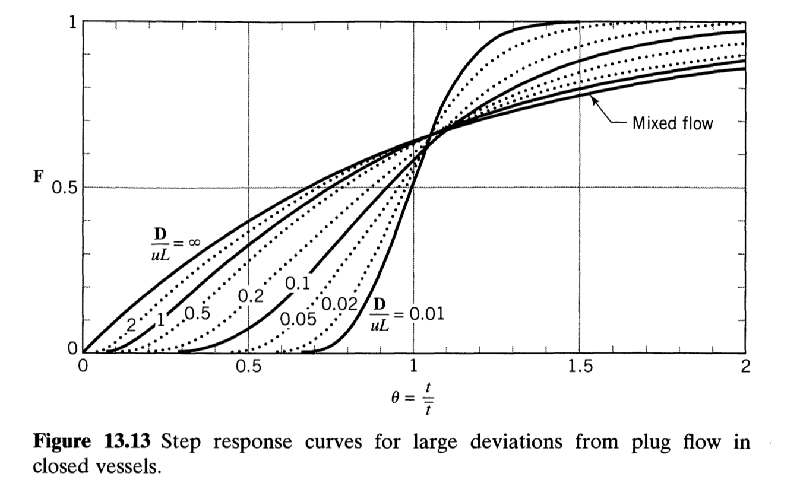
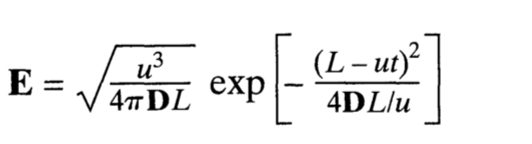
Dispersion Model
Reasons
Slow rise might be the reason of the dispersion

Slide 4
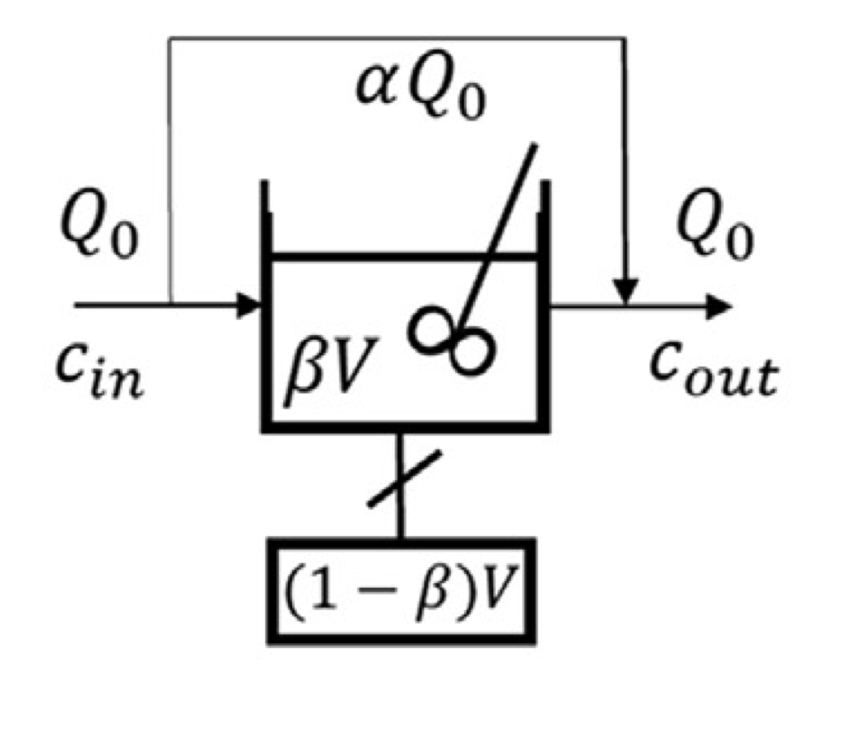
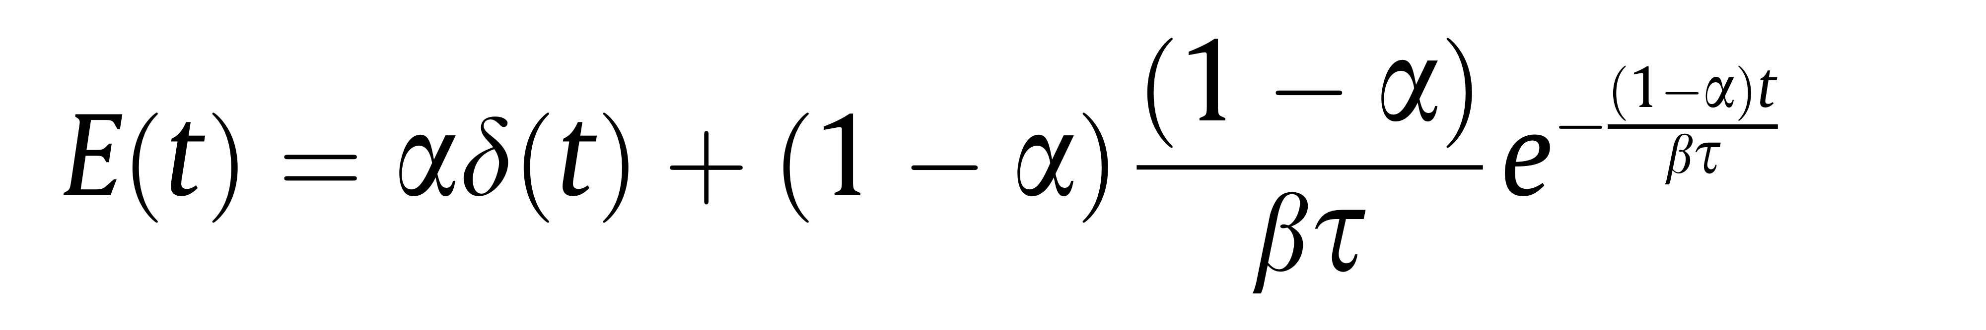
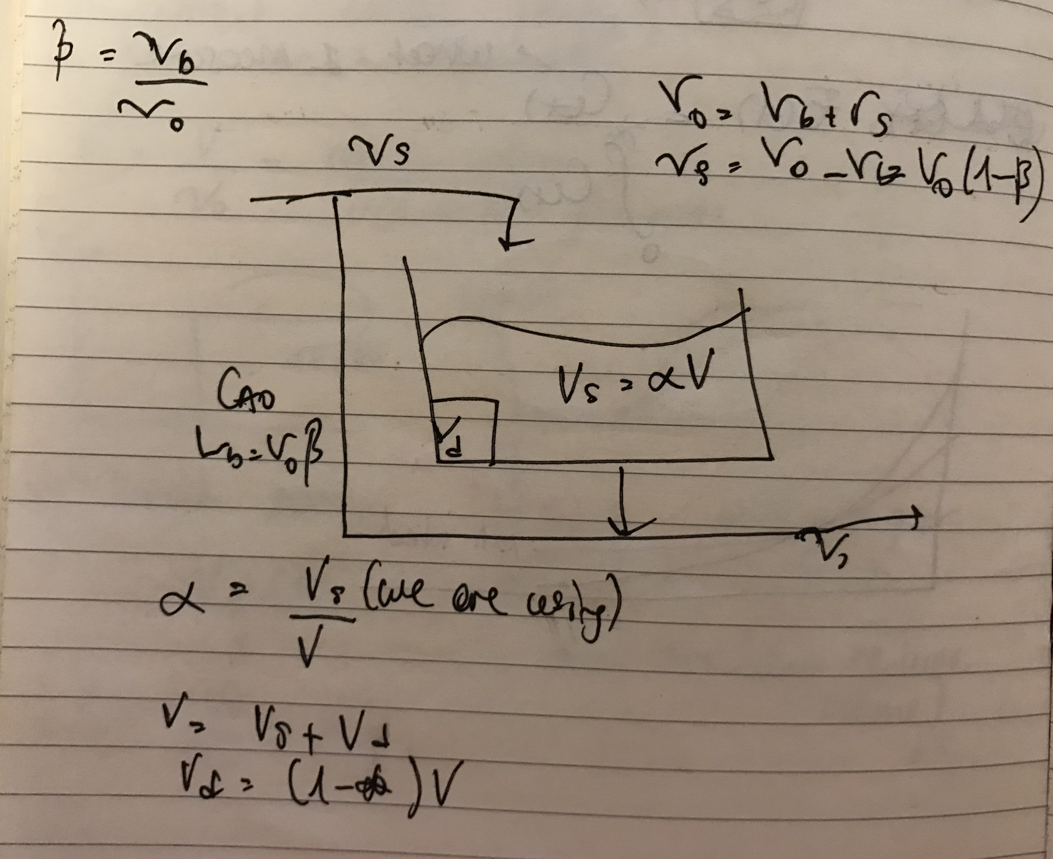
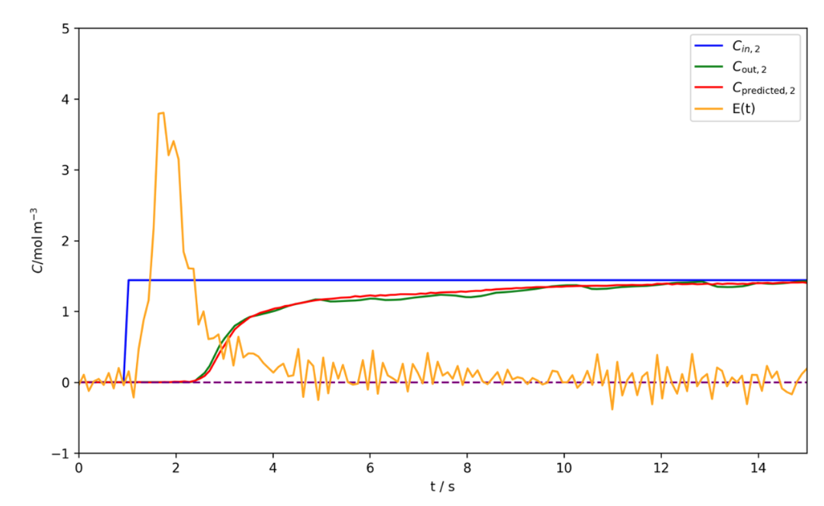
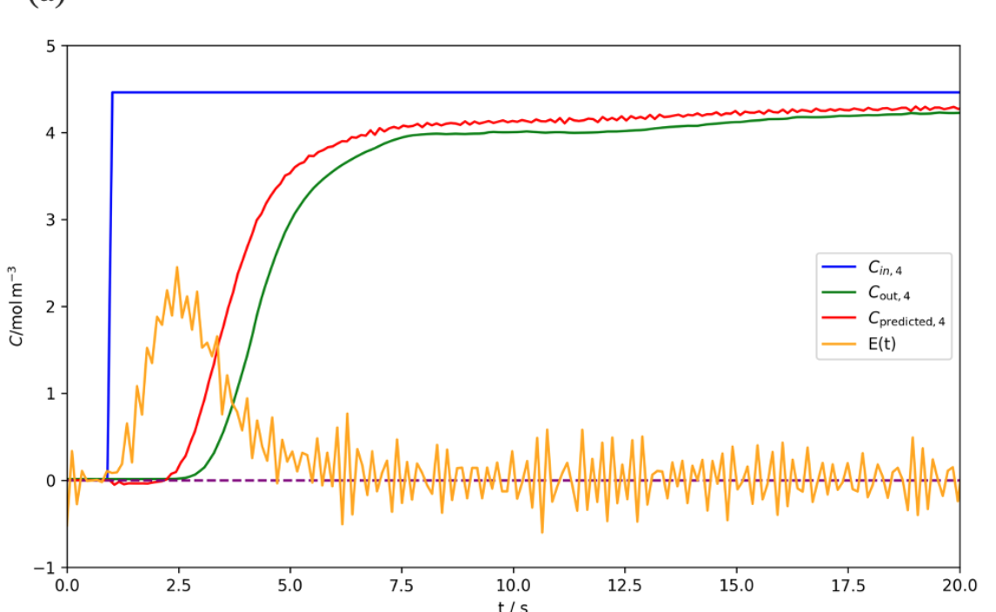
Cholete and Clautier
Reasons
Since the model considers dead zone and bypass
Can fit well if the system has a delayed response and dispersion
Tau = 10-15 s (can be estimated from the time it takes for the output concentration to reach a steady state)
Alfa (bypass) and Beta (dead zone) are fractions so they should be in 0-1 range

Slide 5
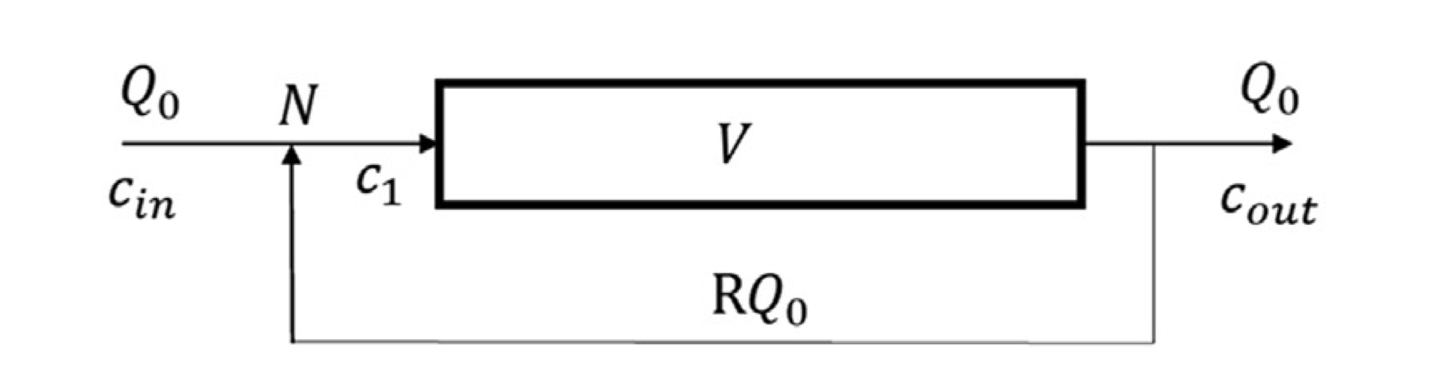
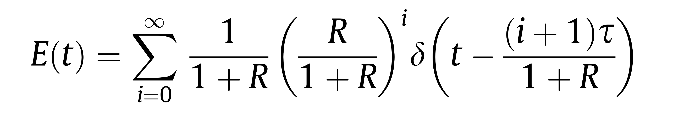
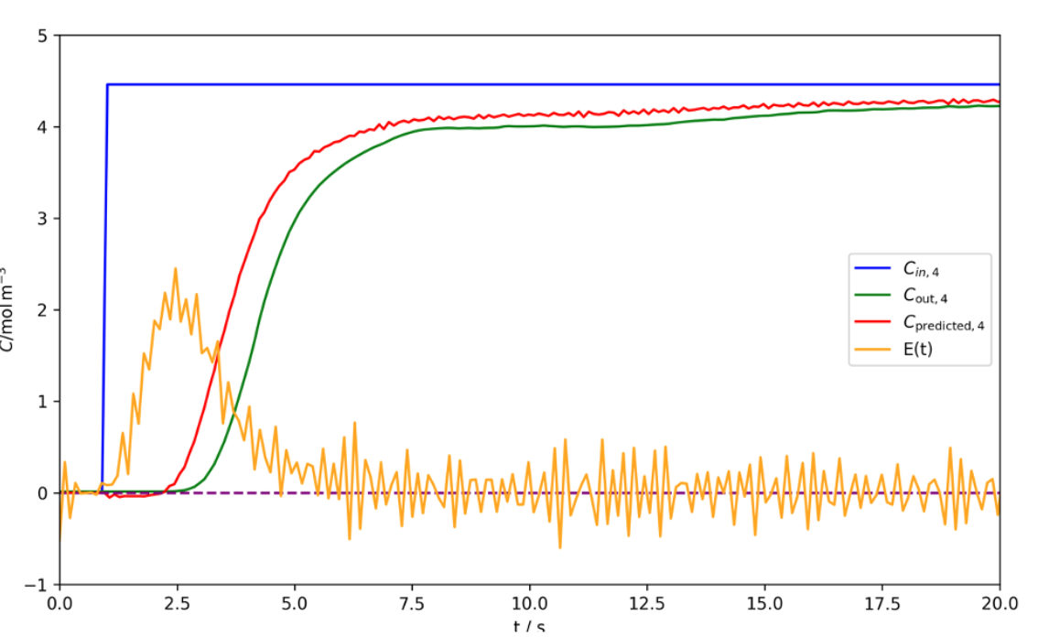
Plug Flow with Recycle
Reasons
Plug flow tends to have a sharp response but recycle introduces oscillation in RTD
Tau = 10-15 s (can be estimated from the time it takes for the output concentration to reach a steady state)
R should be in the range of 0-1

Slide 6
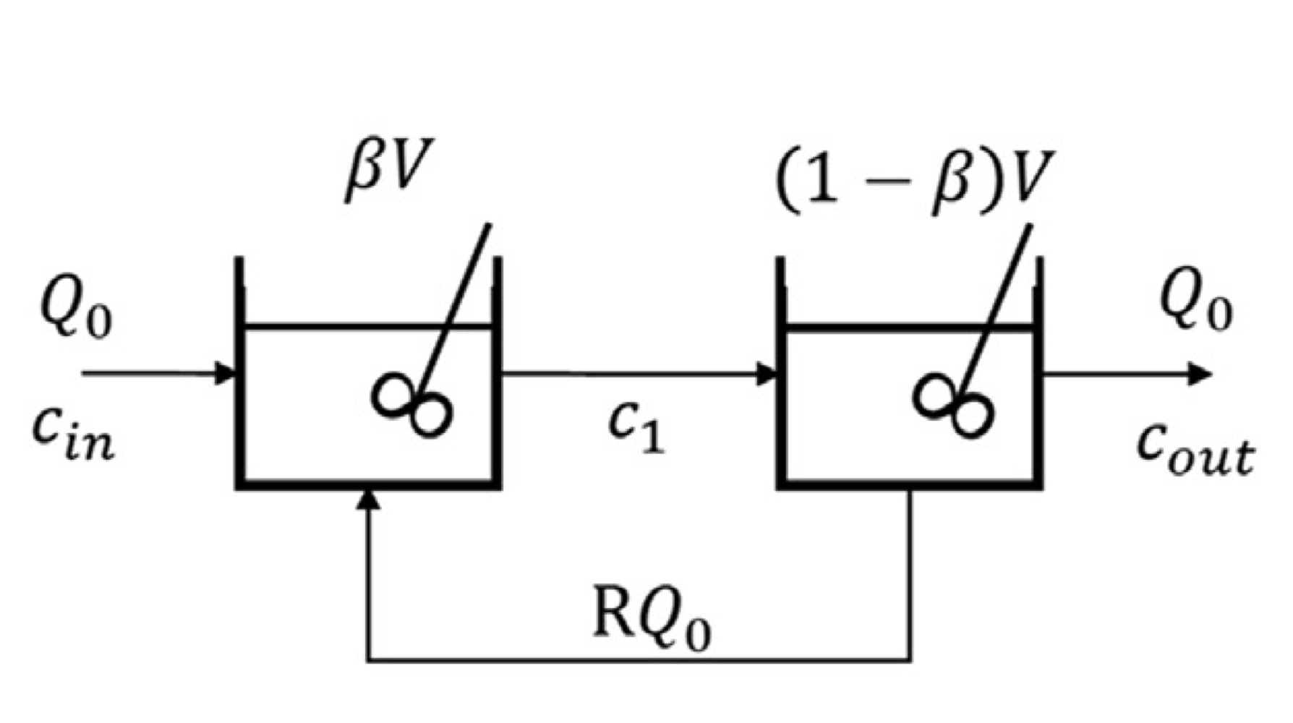
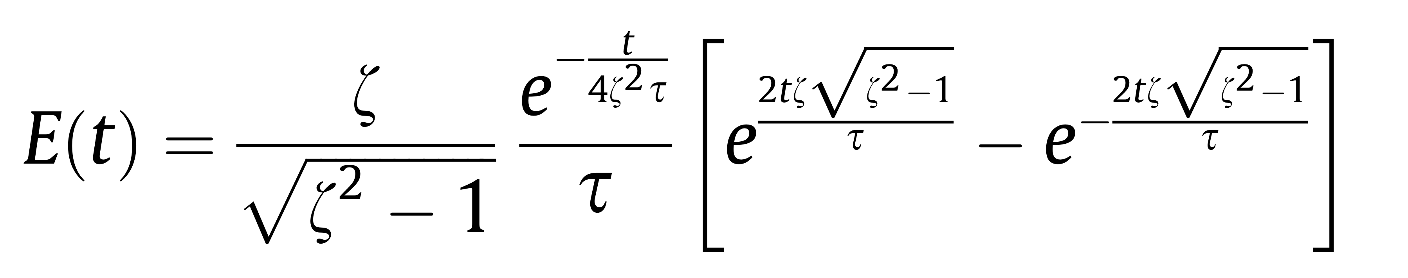
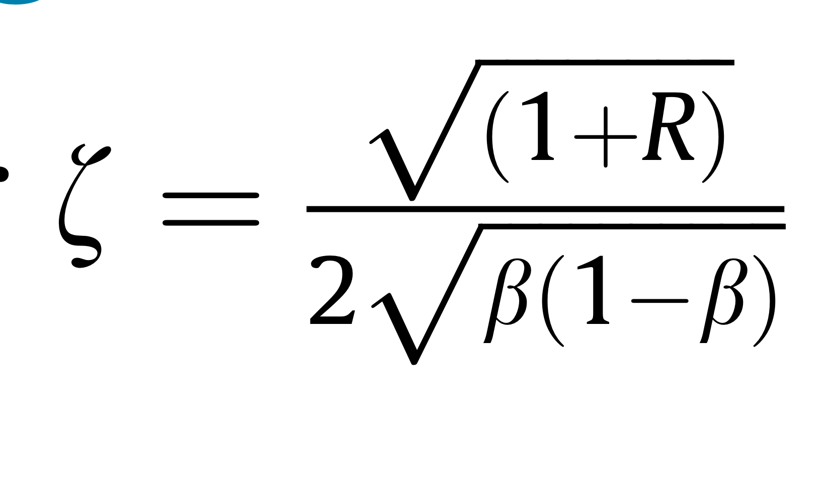
Tank in series with recycle
Reasons
Each tank represents a stage where mixing occurs before the substance moves to the next stage. This creates a cumulative delay effect, loading to a gradual increase in the output concentration. Each oscillation represents a cycle through the system
Tau = 10-15 s (can be estimated from the time it takes for
Beta and R is a fraction so they should be in the range of 0-1

Slide 7
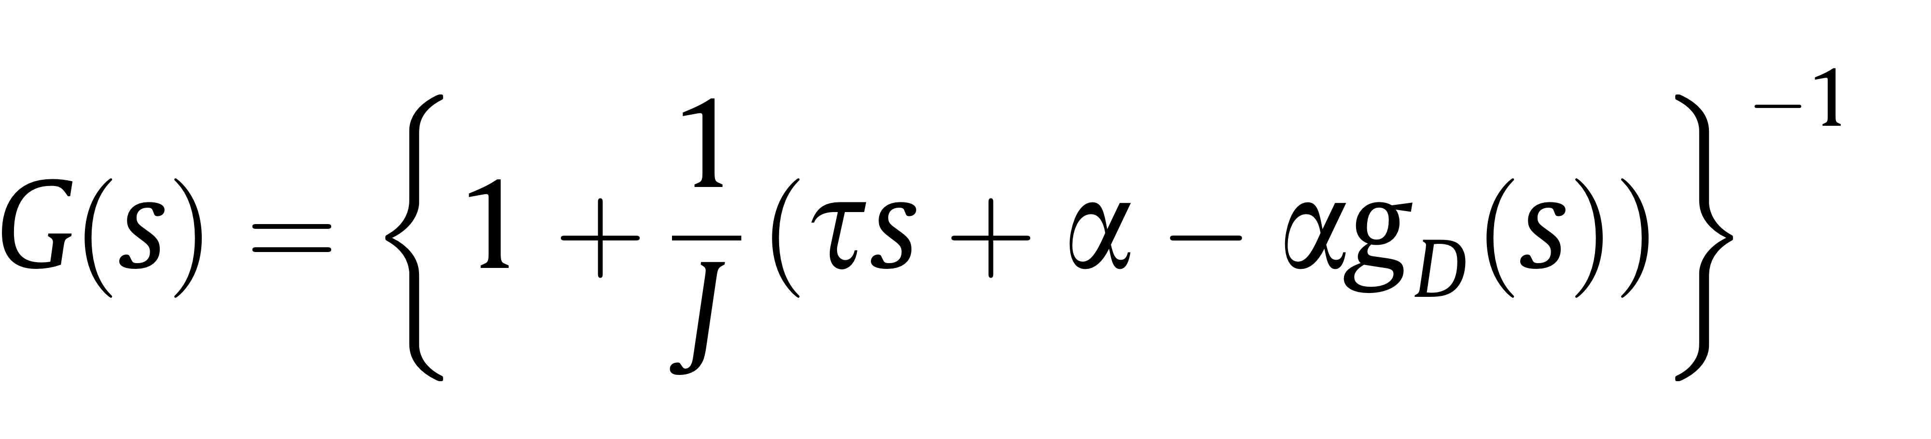
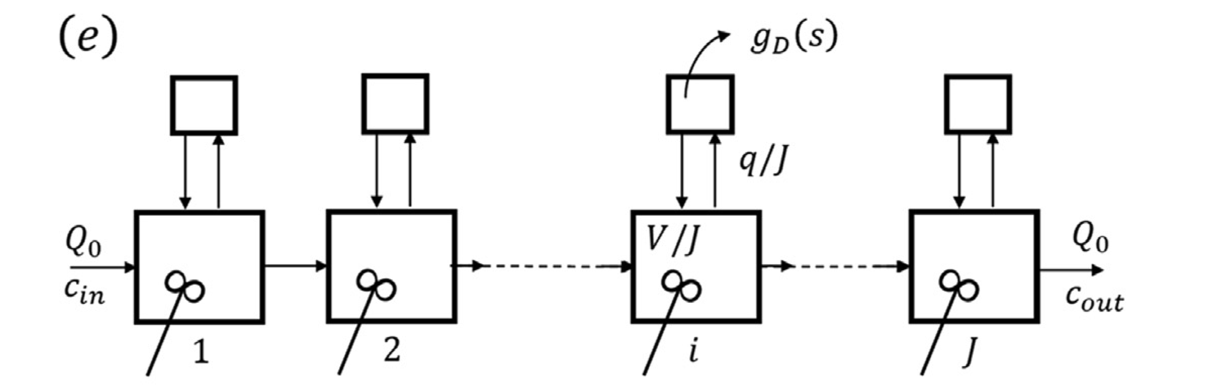
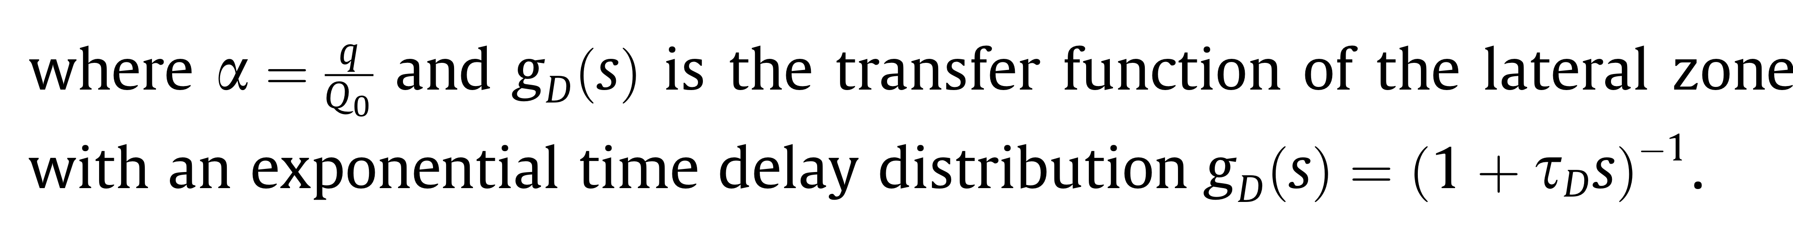
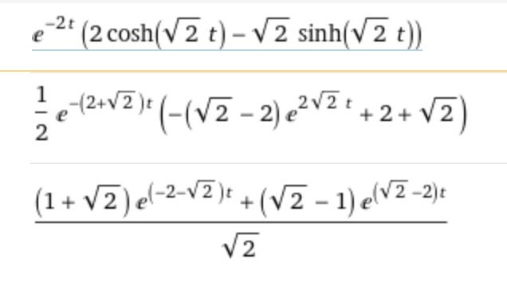
The unified time delay model
J=2
Tau=1
Alfa=1
Inverse Laplace transform

Slide 8
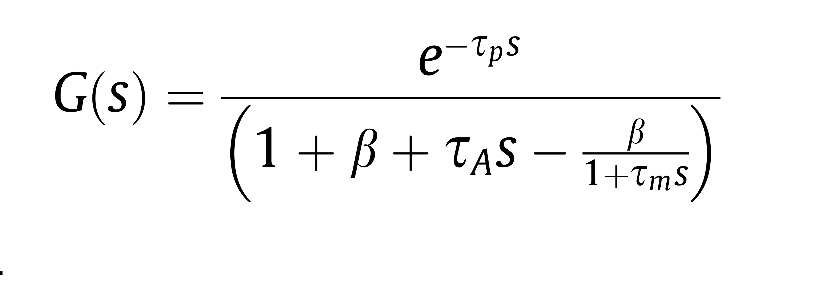
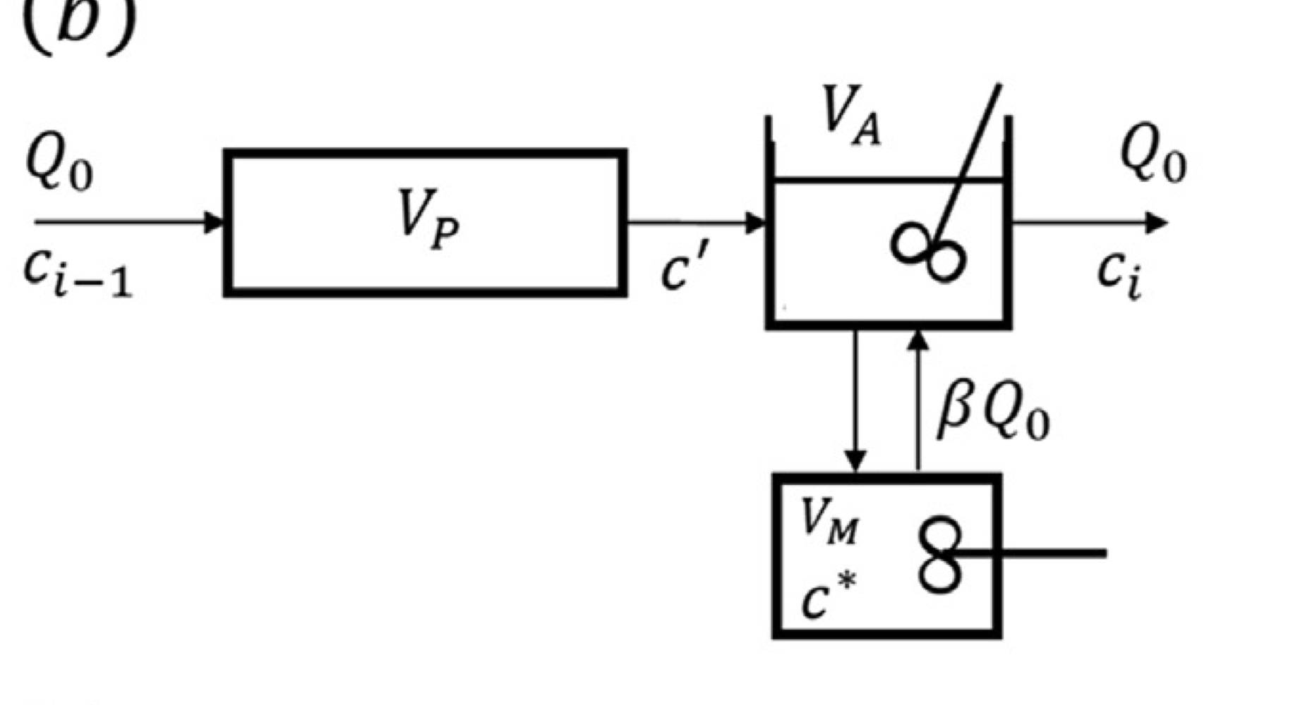
Adler and Hovorka

Slide 9
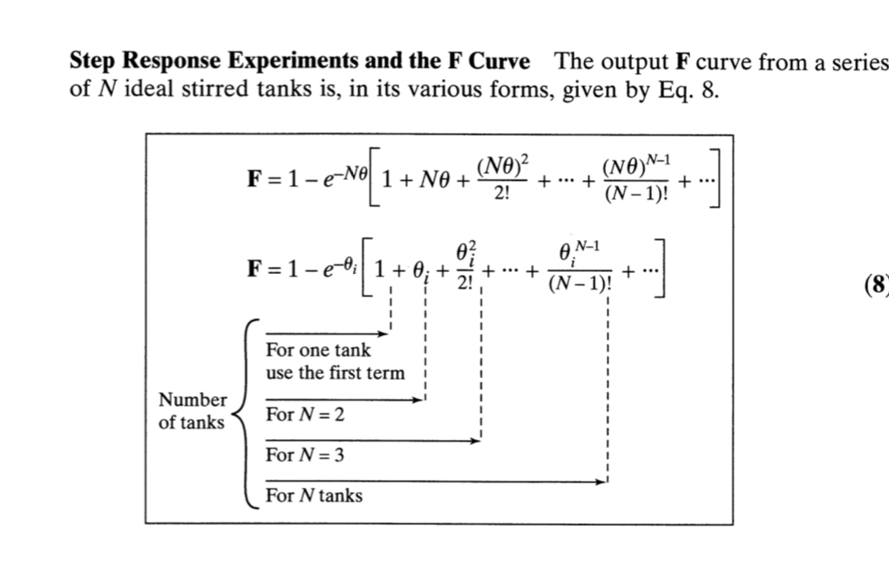
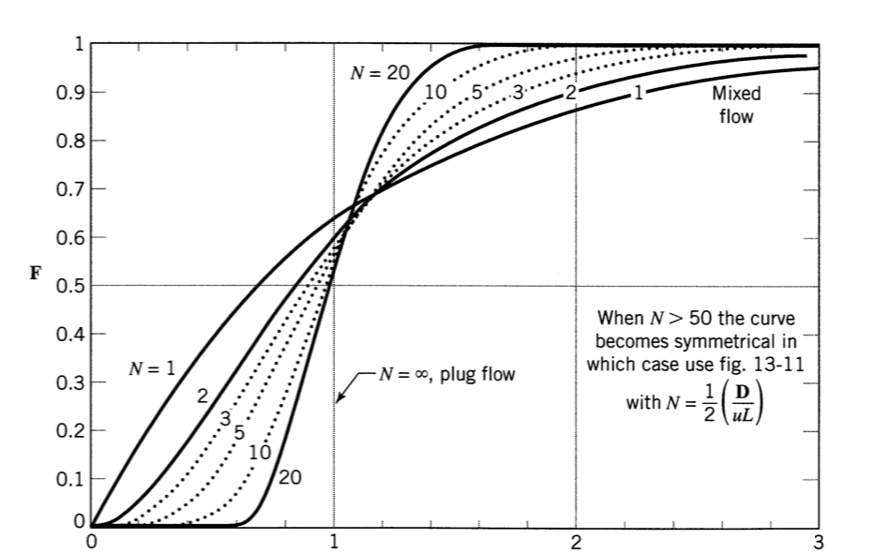
Tank in series
Mean residence time

Slide 10
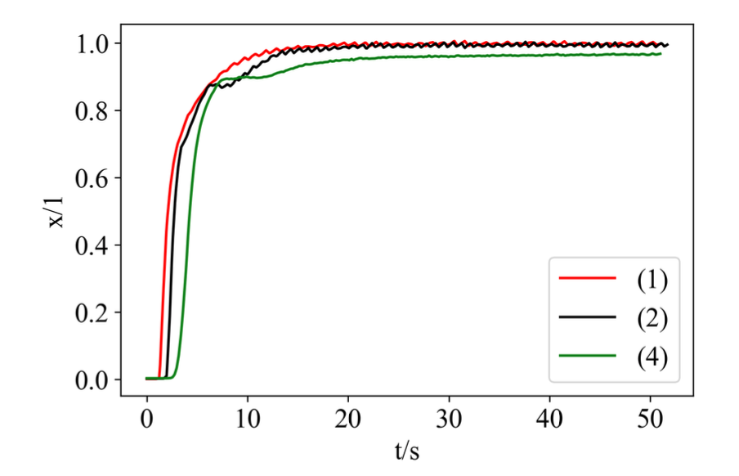
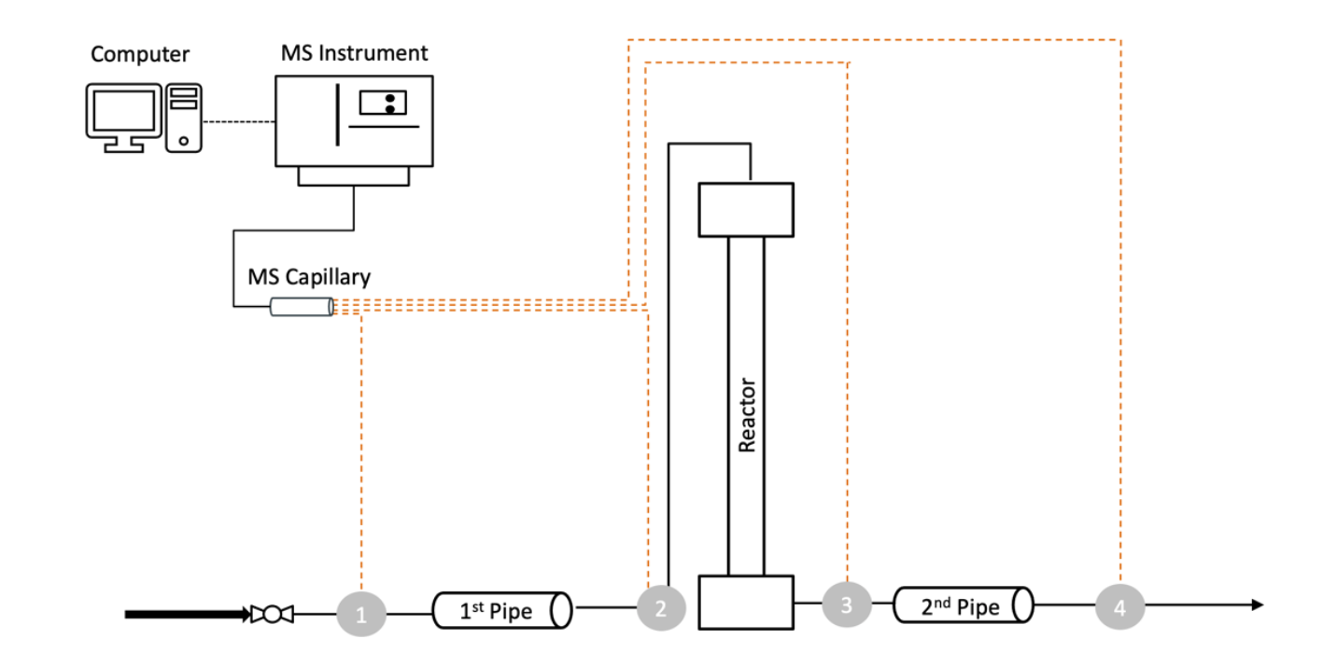
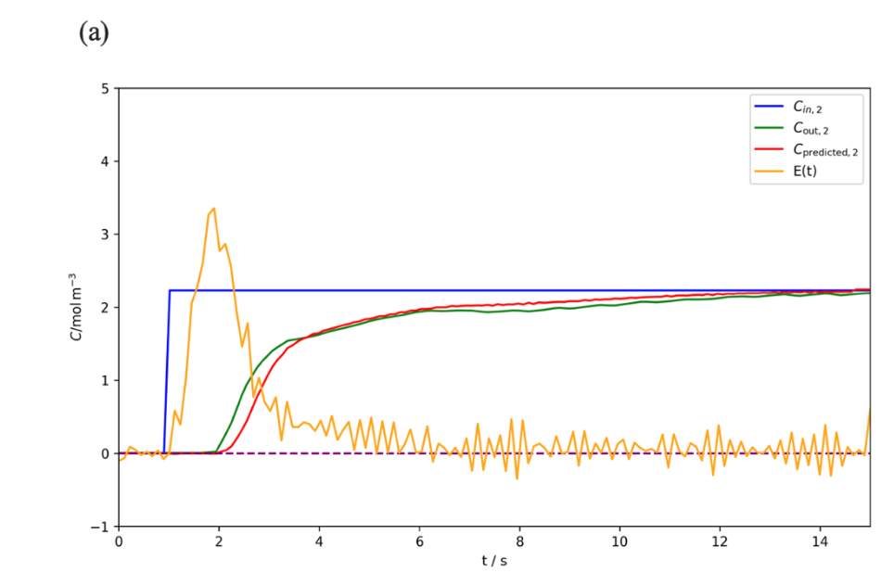
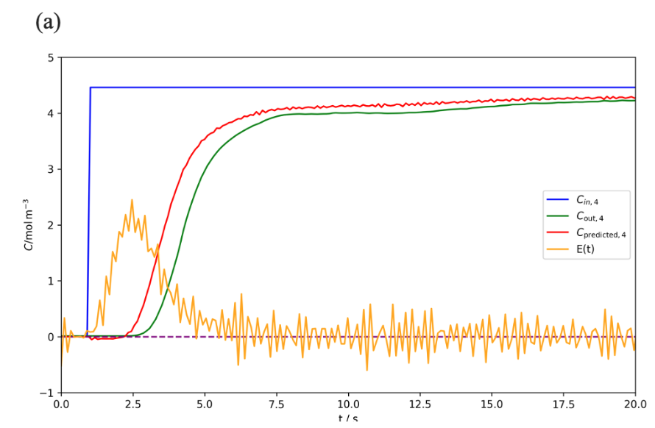
Study

Slide 11
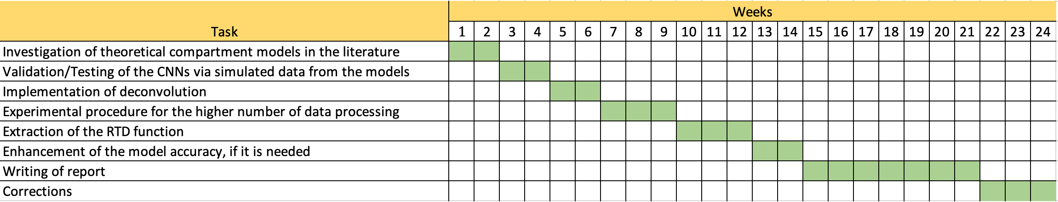
Ganttchart

Slide 12
THANK YOU! I would like to thank Prof. Dr.-Ing. Robert Güttel, M.Sc. Hannes Stagge and M.Sc. Max Gäßler for their guidance and support.

